Slide 1
teNASKA EQUITY FUND CHECK REIMBURSEMENT process and statistics summary

Slide 2
check processing
A team of 2 employees processed 26,207 checks with a value of $6,751,510.27.
Process lasted from Friday May 19th through Wednesday May 24th.
Tasks included printing, folding, and verifying check counts.
Folded checks were then turned over to another team consisting of 5-6 employees who stuffed checks inside envelopes and verified counts.
Envelopes were then turned over to mail room to add postage and re-verify count. Last batch of checks were mailed on Thursday May 25th.

Slide 3
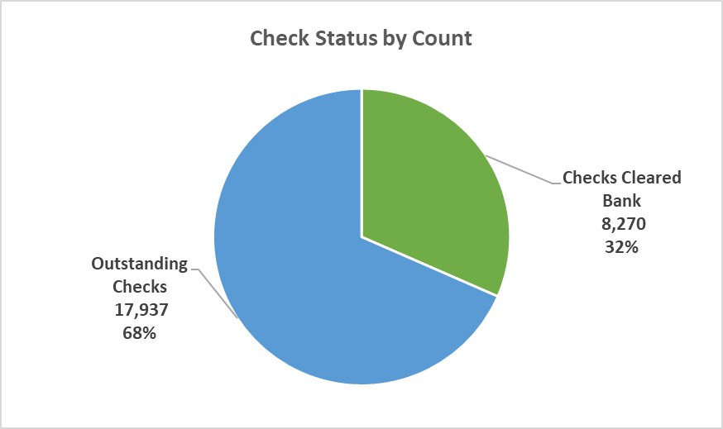
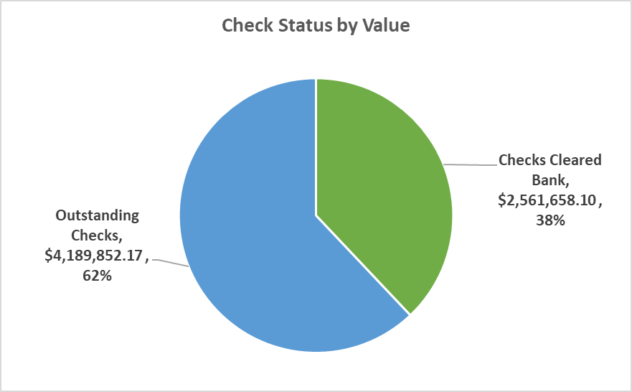
check statistics AS OF June 6, 2023
Total Check Count 26,207
Outstanding Checks Includes 3,141 returned checks
Total Check Value $6,751,510.27

