Slide 1
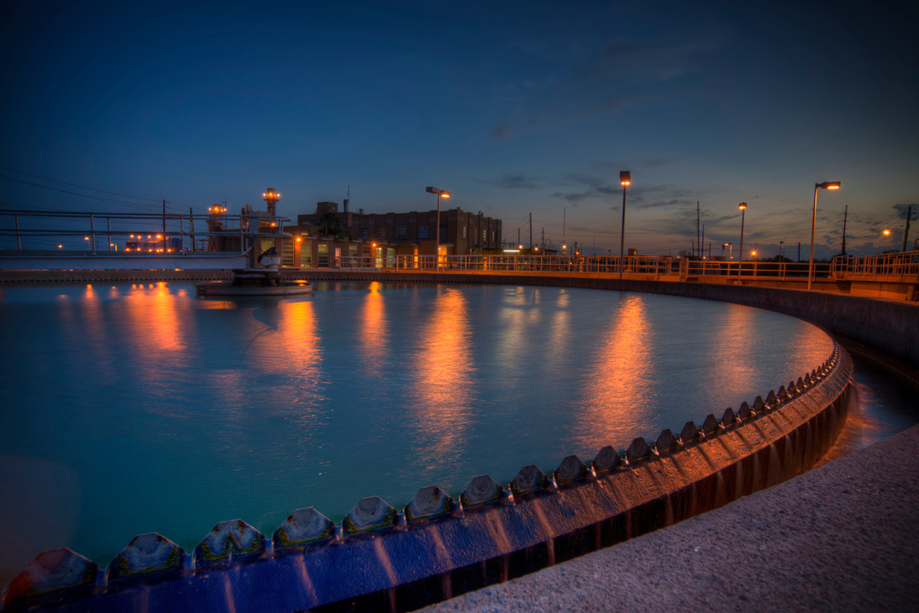
PRESENTATION
COMMUNITY
TOUR

Slide 2
PURPOSE OF TOURS
Share information with key stakeholders about issues, projects and achievements to improve knowledge and support of BPUB.

Slide 3
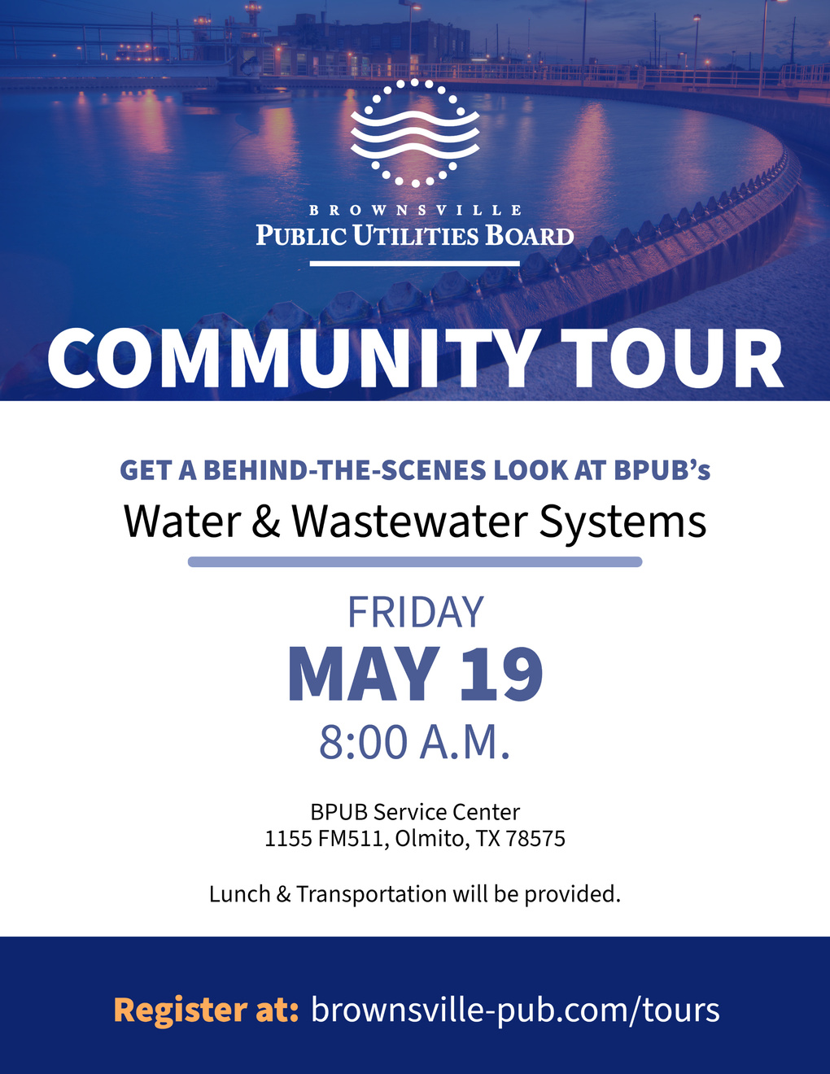

Slide 4
TOUR SITE 1
Southmost Regional Water Authority
Tour of desalination plant by Jose Armando Garza, Water Treatment Manager and Jacob Galvan, W/WW Operator Chief.

Slide 5
TOUR SITE 2
North Wastewater Treatment Plant
Tour by Louis Bennett, Wastewater Treatment Manager; Victor Martinez, W/WW Operator Chief; and Javier Aguirre, Lead W/WW Operator

Slide 6
TOUR SITE 3
Old City Cemetery
Resaca Restoration Project site update by Juan Degollado, Foreman

Slide 7
TOUR SITE 4
Water Treatment Plant No. 1
BPUB River Intake
Tour by Daniel Tamez, W/WW Operator Chief and Rio Grande River and Reservoirs Tour by Guadalupe Garcia, Water Resource Administrator.

Slide 8
THANK YOU
1425 Robinhood Drive
956-983-6462
www.brownsville-pub.com
Questions?

